Slide 1




Salesforce Consumer - Heroku Utility- UmaKant
Heroku is a PaaS which supports languages like Node JS, Java,PHP,Python.
Heroku Connect - exposes data from Heroku Postgres to Salesforce orgs, hence allowing to view, search and relate that data to other objects within Salesforce.
Heroku is part of the Salesforce Platform, enabling enterprises to store and leverage customer data in Salesforce for full-cycle CRM engagement.
Heroku provides intents for Einstein Vision and Language to Analyse the priority of lead based on customer response.
Prospect
2-Way SMS
Customer

Slide 2

Heroku App Functionality-
Rep Business Cards
SMS Messaging
Creates and delivers vcf file to mobile device
Supports Image Preview
Works across all current known Android / IOS devices
Deliver Outbound SMS to customers / prospects
Scales to massive amounts to support holiday periods
Applies business rules as necessary

Slide 3
SMS Engagement Overview
When can customers be contacted?
All messages going from salesforce are sent to customers during business hours which are:
Monday - Friday: 9AM to 8PM
Saturday: 10AM to 6PM
Timezones : AKST, CST, EST, HAST, MST, PST, and Telesales EST
Is any content required in messages?
Messages to Verizon customers must include “FreeVzMsg” at the end of the SMS
Messages to prospects must Include “Msg data rates apply” at the end of the SMS
How many times can customers be contacted?
For every one customer response a rep can send 3 free form replies. Free form replies are queued to be sent during business hours.
How long can messages be?
With message concatenation messages are capped at 700 characters.
How do customers opt out of messaging?
Customer replies “E” to a message and no longer will receive messages for that event
Customer replies “E” and then “X” if they want to opt out at the account level (DNS = true)
What happens if a lead attempts to confirm their message was received?
An automated reply will be sent during business hours to confirm that the lead’s message was received and that a rep will respond shortly
What happens if a lead requires action?
Reps and managers are messaged to their best device during store business hours to alert them when a lead requires action

Slide 4
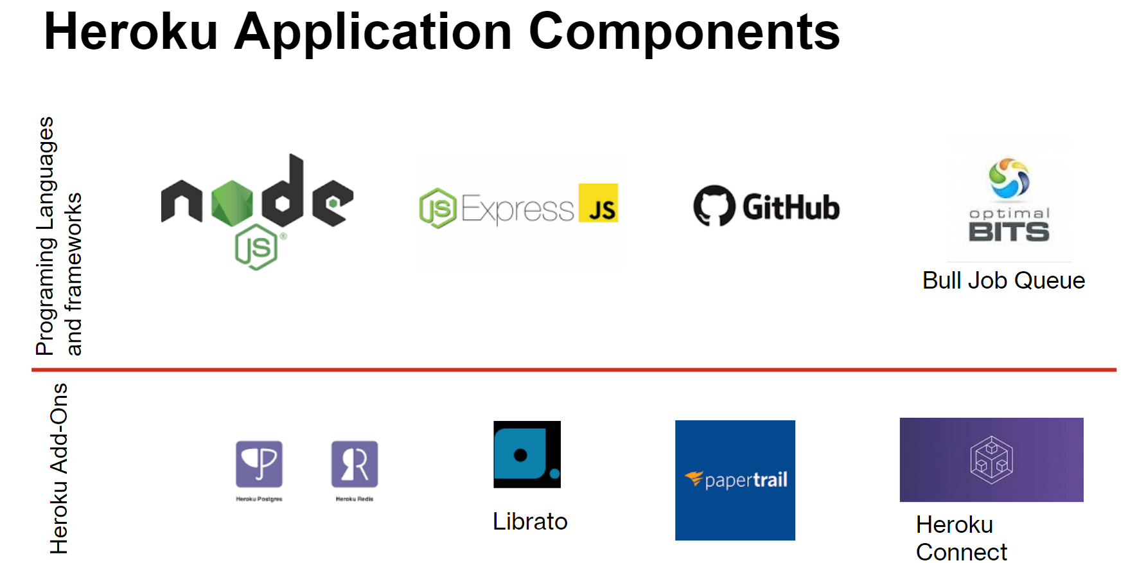

Heroku Postgres is using for database and all data storing in it.
Heroku Redis is using for Bull to manage the queue of background jobs.
Librato is using for Matrix.
Papertrail is using for Logs.
Heroku Connect is using for pulling SFDC Object.

Slide 5
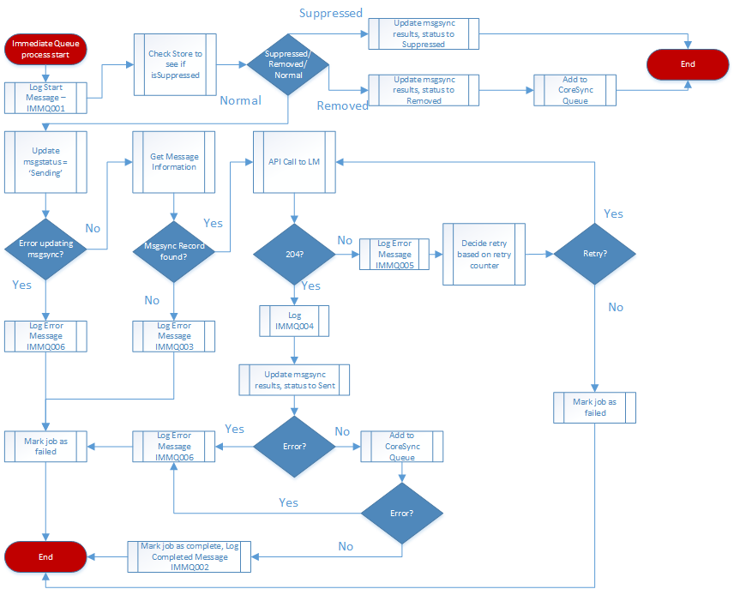
Immediate SMS Queue worker Functionality
Immediate SMS Queue sends messages out immediate without the limit of timezones and business hours.

Slide 6
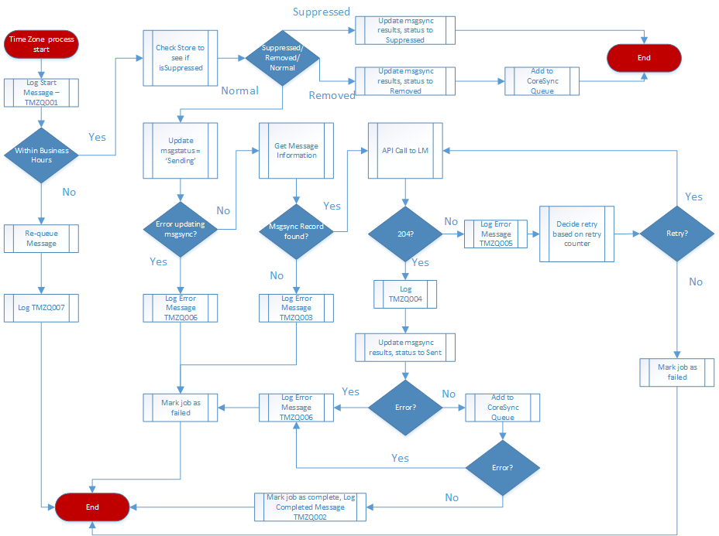
Time Zone Queue worker Functionality
Each time zone worker processes all messages that are within the given time zone. Any messages scheduled outside of business hours will be re-queued back into the queue.

Slide 7
Time Zone | Job Rate / Second
EST | 10
CST | 4
MST | 2
PST | 2
AKST | 1
HAST | 1

Slide 8

Einstein Language Functionality
The Einstein language functionality syncs data from Inbound customer responses, sends it to the Einstein endpoint for intent and sentiment analysis, determines the priority and generates an automated response. Once the automated response is created, this message is added to the msgsync table and then is picked up by the dispatcher and then eventually sent out and synced back to Salesforce.

Slide 9
